Slide 1
Statistical Methods in Research
Final Project
Mohit G Kaduskar - 1544187
Nafisa Jassani - 1543203

Slide 2
Introduction
4different conditions: No distraction, cognitive distraction, emotional distraction, and sensorimotor distraction.
Stress is assessed through a number of peripheral physiological measures in such cases: perinasal perspiration, palm EDA, breathing rate, and heart rate.
To ensure the validity of the dataset.
Using statistical tests we need to determine which of the measures: perinasal perspiration, palm EDA, breathing rate, and heart rate, signify significant elevation of stress and which are not, and comment on the results.

Slide 3
Data Cleaning
Assumptions:
If data is in valid range for both the particular Session (CD, ED or MD) as well as for ND for a particular subject, only then we calculate the mean of that subject.
If the data for stm file for a particular subject is not present we ignore that subject.
Methodology:
In phase 1, we have checked the validity of data, and assigned value of 1 if the data was within the valid range for that particular file.
Datachannel -> Session -> Phase -> calculate means -> find difference of mean from mean of ND.
(datachannel).(Session).ND.(Phase) eg. HR.CD.ND.Ph1- This is for the vector corresponding to mean of the session - mean of session ND.

Slide 4
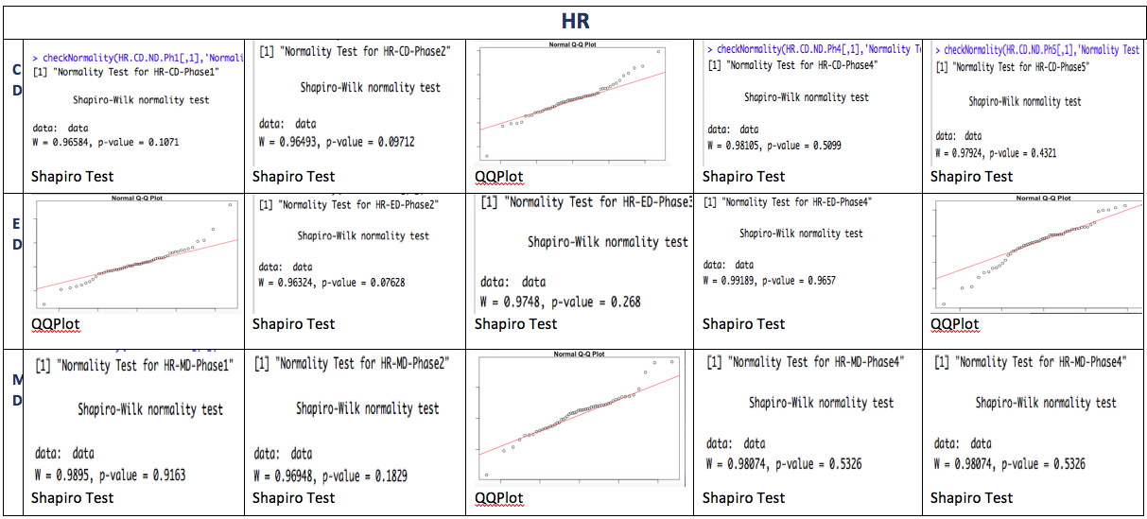
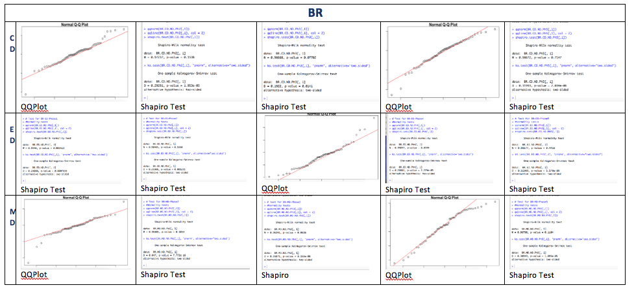
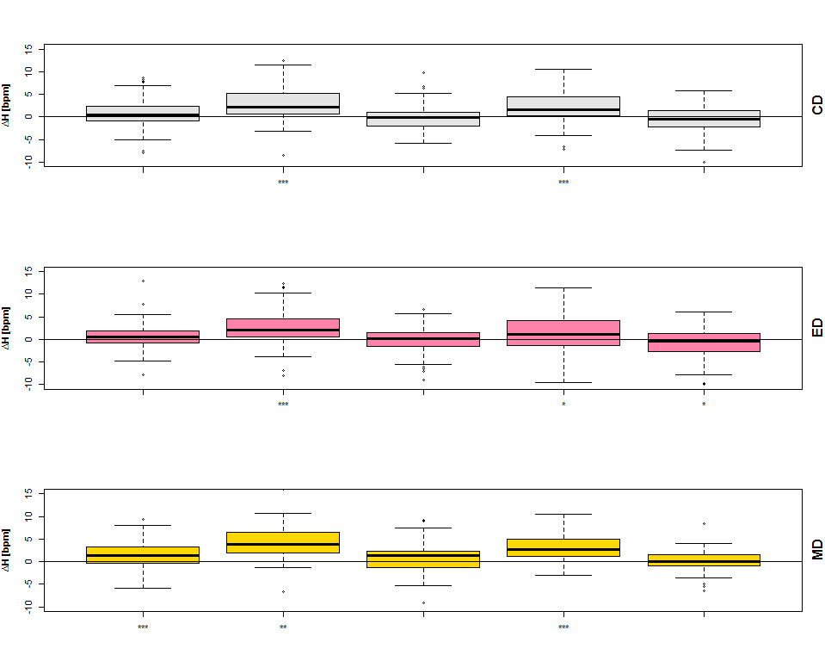
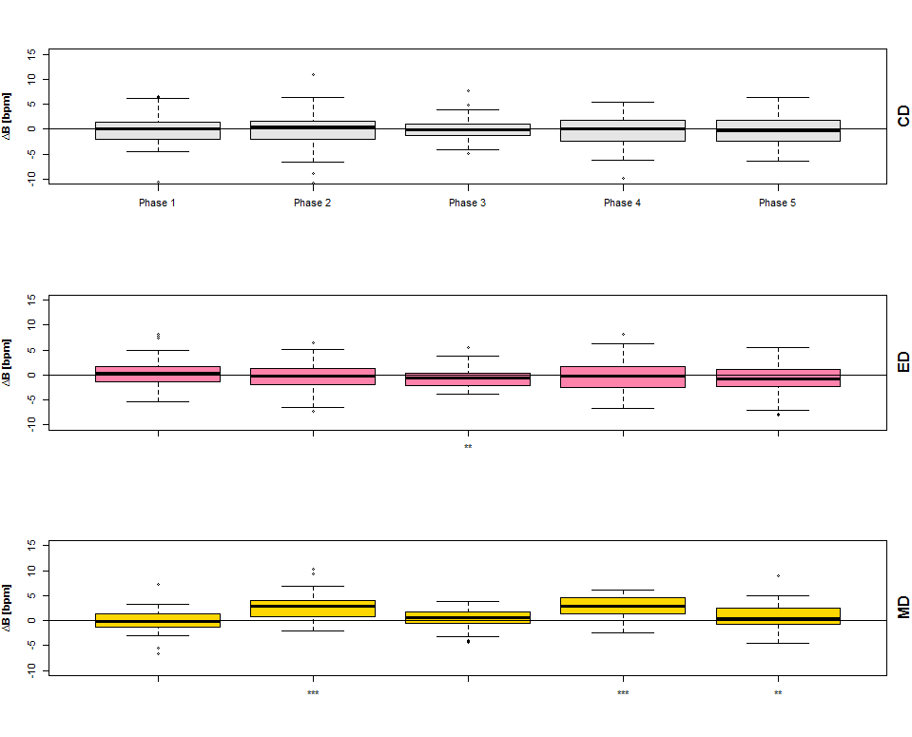
Results and Observations
BR Phase | Normality? Pass/Fail | Transformation | T-test | Significance Level
CD - 1 | QQPlot: Pass | Not needed | p=0.8455 > 0.0125 -> fail to reject the null hypothesis | No Star
CD - 2 | Shapiro: Pass | Not needed | p=0.8226 > 0.0125 -> fail to reject the null hypothesis | No Star
CD - 3 | Shapiro: Pass | Not needed | p=0.7267 > 0.0125 -> fail to reject the null hypothesis | No Star
CD - 4 | QQPlot: Pass | Not needed | p=0.3112 > 0.0125 -> fail to reject the null hypothesis | No Star
CD - 5 | Shapiro: Pass | Not needed | p=0.5269 > 0.0125 -> fail to reject the null hypothesis | No Star
ED - 1 | Shapiro: Pass | Not needed | p=0.2724 > 0.0125 -> fail to reject the null hypothesis | No Star
ED - 2 | Shapiro: Pass | Not needed | p=0.3606 > 0.0125 -> fail to reject the null hypothesis | No Star
ED - 3 | QQPlot: Pass | Not needed | p=0.005203 < 0.0125 -> reject the null hypothesis | **
ED - 4 | Shapiro: Pass | Not needed | p=0.5786 > 0.0125 -> fail to reject the null hypothesis | No Star
ED - 5 | Shapiro: Pass | Not needed | p=0.08342 > 0.0125 -> fail to reject the null hypothesis | No Star
MD - 1 | QQPlot: Pass | Not needed | p=0.3604 > 0.0125 -> fail to reject the null hypothesis | No Star
MD - 2 | Shapiro: Pass | Not needed | p=6.24e−13 < 0.0125 -> reject the null hypothesis | ***
MD - 3 | Shapiro: Pass | Not needed | p=0.06859 > 0.0125 -> fail to reject the null hypothesis | No Star
MD - 4 | QQPlot: Pass | Not needed | p=3.729e−15 < 0.0125 -> reject the null hypothesis | ***
MD - 5 | Shapiro: Pass | Not needed | p=0.007066 < 0.0125 -> reject the null hypothesis | **
HR Phase | Normality? Pass/Fail | Transformation | T-test | Significance Level
CD - 1 | Shapiro: Pass | Not needed | p=0.1255 > 0.0125 -> fail to reject the null hypothesis | No Star
CD - 2 | Shapiro: Pass | Not needed | p=1.066e−07 < 0.0125 -> reject the null hypothesis | ***
CD - 3 | QQPlot: Pass | Not needed | p=0.6306 > 0.0125 -> fail to reject the null hypothesis | No Star
CD - 4 | Shapiro: Pass | Not needed | p=0.0001288 < 0.0125 -> reject the null hypothesis | ***
CD - 5 | Shapiro: Pass | Not needed | p=0.2258 > 0.0125 -> fail to reject the null hypothesis | No Star
ED- 1 | QQPlot: Pass | Not needed | p=0.128 > 0.0125 -> fail to reject the null hypothesis | No Star
ED- 2 | Shapiro: Pass | Not needed | p=0.0003597 < 0.0125 -> reject the null hypothesis | ***
ED- 3 | Shapiro: Pass | Not needed | p=0.7404 > 0.0125 -> fail to reject the null hypothesis | No Star
ED - 4 | Shapiro: Pass | Not needed | p=0.03065 > 0.0125 -> fail to reject the null hypothesis | *
ED - 5 | QQPlot: Pass | Not needed | p=0.04165 > 0.0125 -> fail to reject the null hypothesis | *
MD - 1 | Shapiro: Pass | Not needed | p= 0.000376 < 0.0125 -> reject the null hypothesis | ***
MD - 2 | Shapiro: Pass | Not needed | p=0.9.48e-11< 0.0125 -> reject the null hypothesis | ***
MD - 3 | QQPlot: Pass | Not needed | p=0.06392> 0.0125 -> fail to reject the null hypothesis | No Star
MD - 4 | Shapiro: Pass | Not needed | p=1.78 e-09 < 0.0125 -> reject the null hypothesis | ***
MD - 5 | Shapiro: Pass | Not needed | p=0.8266 > 0.0125 -> fail to reject the null hypothesis | No Star

Slide 5
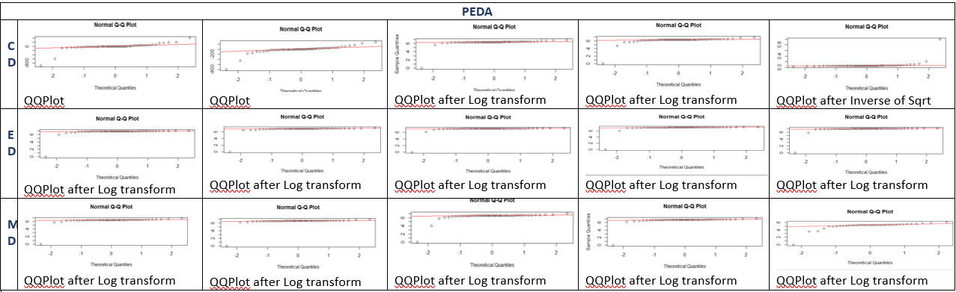
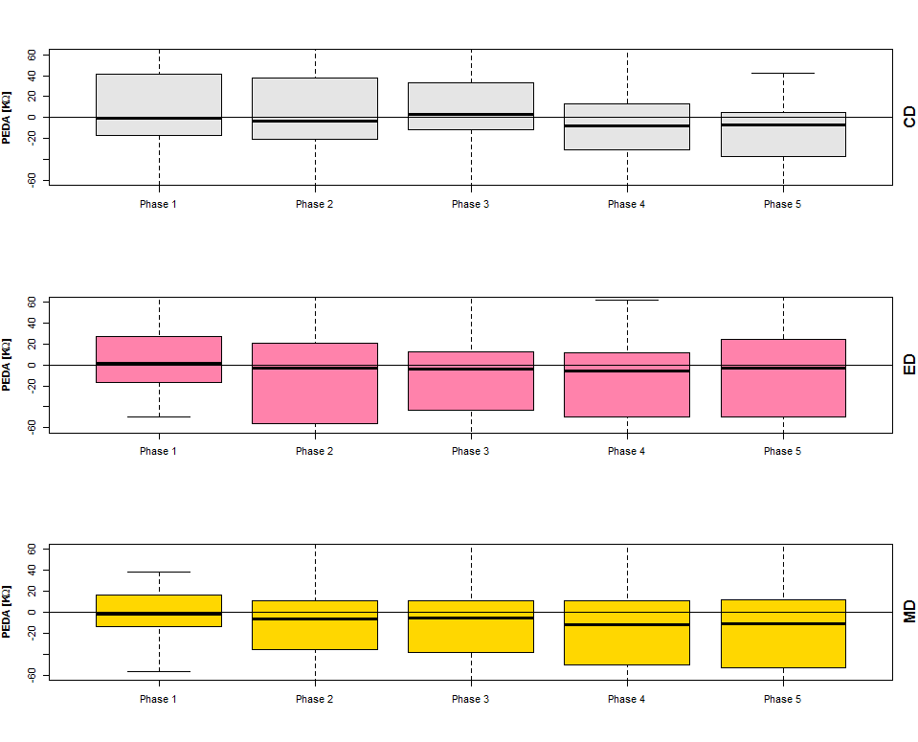
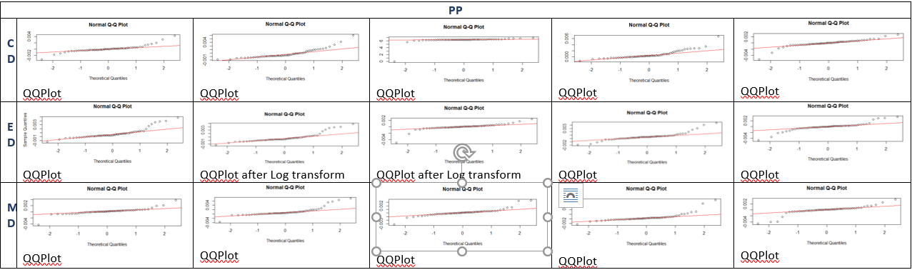
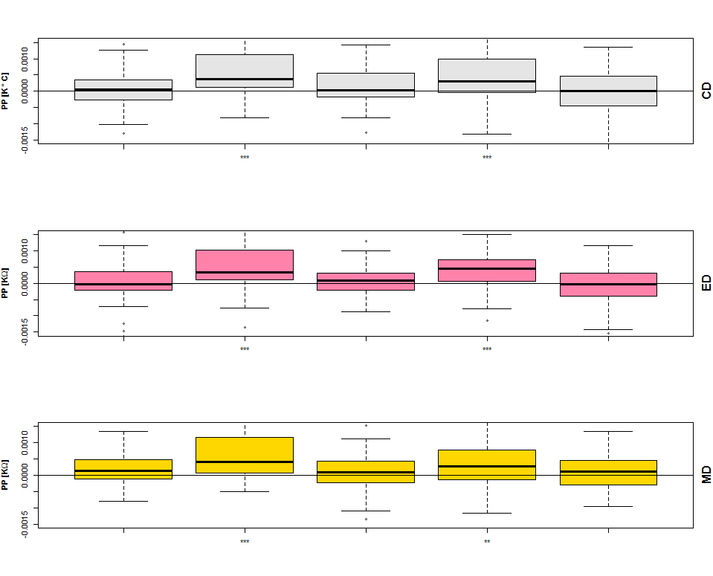
Results and Observations
Peda Phase | Normality? Pass/Fail | Transformation | T-test | Significance Level
CD - 1 | QQPlot: Pass | Not needed | p=0.8598 > 0.0125 -> fail to reject the null hypothesis | No Star
CD - 2 | QQPlot: Pass | Not needed | p=0.5915 > 0.0125 -> fail to reject the null hypothesis | No Star
CD - 3 | Failed | Log | p=0.4046 > 0.0125 -> fail to reject the null hypothesis | No Star
CD - 4 | Failed | Log | p=0.1906 > 0.0125 -> fail to reject the null hypothesis | No Star
CD - 5 | Failed | Inverse of Square Root | p=0.1734 > 0.0125 -> fail to reject the null hypothesis | No Star
ED - 1 | Failed | Log | p=0.2295 > 0.0125 -> fail to reject the null hypothesis | No Star
ED - 2 | Failed | Log | p=0.2127 > 0.0125 -> fail to reject the null hypothesis | No Star
ED - 3 | Failed | Log | p=0.2118 > 0.0125 -> fail to reject the null hypothesis | No Star
ED - 4 | Failed | Log | p=0.2183 > 0.0125 -> fail to reject the null hypothesis | No Star
ED - 5 | Failed | Log | p=0.2077 > 0.0125 -> fail to reject the null hypothesis | No Star
MD - 1 | Failed | Log | p=0.3183 > 0.0125 -> fail to reject the null hypothesis | No Star
MD - 2 | Failed | Log | p=0.2714 > 0.0125 -> fail to reject the null hypothesis | No Star
MD - 3 | Failed | Log | p=0.1459 > 0.0125 -> fail to reject the null hypothesis | No Star
MD - 4 | Failed | Log | p=0.2075 > 0.0125 -> fail to reject the null hypothesis | No Star
MD - 5 | Failed | Log | p=0.09044 > 0.0125 -> fail to reject the null hypothesis | No Star
pp Phase | Normality? Pass/Fail | Transformation | T-test | Significance Level
CD - 1 | QQPlot: Pass | Not needed | p=0.3382 > 0.0125 -> fail to reject the null hypothesis | No Star
CD - 2 | QQPlot: Pass | Not needed | p=6.515e-06 < 0.0125 -> reject the null hypothesis | ***
CD - 3 | QQPlot: Pass | Not needed | p=0.01876 > 0.0125 -> fail to reject the null hypothesis | *
CD - 4 | QQPlot: Pass | Not needed | p=0.0001348 < 0.0125 -> reject the null hypothesis | ***
CD - 5 | QQPlot: Pass | Not needed | p=0.7934 > 0.0125 -> fail to reject the null hypothesis | No Star
ED - 1 | QQPlot: Pass | Not needed | p=0.3002 > 0.0125 -> fail to reject the null hypothesis | No Star
ED - 2 | QQPlot: Pass | Not needed | p=8.158e-06 < 0.0125 -> reject the null hypothesis | ***
ED - 3 | QQPlot: Pass | Not needed | p=0.8054 > 0.0125 -> fail to reject the null hypothesis | No Star
ED - 4 | QQPlot: Pass | Not needed | p=0.0002019 < 0.0125 -> reject the null hypothesis | ***
ED - 5 | QQPlot: Pass | Not needed | p=0.797 > 0.0125 -> fail to reject the null hypothesis | No Star
MD - 1 | QQPlot: Pass | Not needed | p=0.1865 > 0.0125 -> fail to reject the null hypothesis | No Star
MD - 2 | QQPlot: Pass | Not needed | p=0.000117 < 0.0125 -> reject the null hypothesis | ***
MD - 3 | QQPlot: Pass | Not needed | p=0.2834 > 0.0125 -> fail to reject the null hypothesis | No Star
MD - 4 | QQPlot: Pass | Not needed | p=0.003815 < 0.0125 -> reject the null hypothesis | **
MD - 5 | QQPlot: Pass | Not needed | p=0.907 > 0.0125 -> fail to reject the null hypothesis | No Star

Slide 6
Conclusion and Challenges
Stars denote the significance of the stress applied.
For perinasal perspiration, breathing rate, and heart rate, the stars in signify significant elevation of stress.
For palm EDA, we observe that the stress did not elevate significantly.
Challenges:
Deciding when to eliminate a signal -> Assumptions.
Shapiro and KS test did not prove the data normal for most of the cases.
QQLine on QQPlot deviated due to outliers -> Manually removed extreme cases and then re-plotted.

